Slide 1


SAP FULL-STACK DEVELOPER TRAINING
ABAP on HANA, UI5 & Fiori, Analytics with OData
Anubhav Oberoy
Day – 1

Slide 2

INTRODUCTION

Slide 3

Agenda – Day 1
Introduction to SAP UI5
What is SAP UI5?
Under the Hood of SAP UI5
UI5 Development Tools
Installation of development Tools
Introduction to HTML
Introduction to CSS
--Break--
JavaScript Introduction
Difference b/w Synchronous and Asynchronous
Array and Object
Introduction to jQuery
Introduction to the UI5 SDK

Slide 4


What is SAP UI5?
SAPUI5 (SAP user interface for HTML5) is a collection of libraries that you can use to build desktop and mobile applications that run in a browser. With the SAPUI5 JavaScript toolkit, you can create web applications using HTML5 web development standards.
SAP UI5 is a framework which is used to develop Responsive web applications to run on any platform, any browser and any OS.
Responsive
App which can adapt itself according the different devices
Framework
It’s a collection of Libraries.
Library
Collection of classes.
Classes
Collection of methods, Attributes, Events
Software Innovation
Hardware Innovation

Slide 5
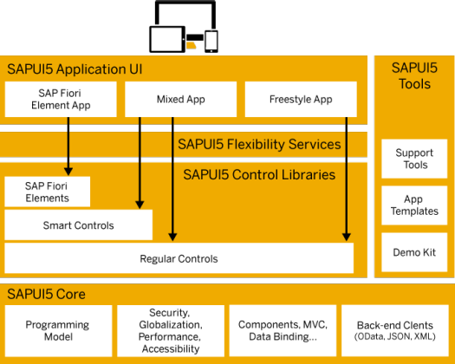
Under the Hood of SAP UI5
SAPUI5 simplifies web application development. A variety of UI controls, ranging from basic elements to complex UI patterns, can be combined for an appealing layout. All UI controls leverage a consistent design language and coherent UX patterns. SAPUI5 flexibility services let you easily adapt the UI of an app and store the changes in a layered repository.
Trainer: Anubhav Oberoy

Slide 6

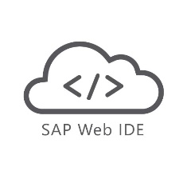

UI5 Development Tools
Development Tools
BAS is the latest technology provided by SAP for Development
Eclipse
Web IDE
SAP Web IDE comes in two type
Business Application Studio (BAS)
Eclipse development tools is Obsolete
It is no longer supported by the SAP
But we can still use it for local development in our system.
This tool is a Dead technology.
Web IDE Personal Edition
Web IDE Full-Stack
SAP Business Application Studio is the next generation of the iconic SAP Web IDE.
It comes out of the box with predefined set of development environments – Dev-Spaces (virtual machine on the cloud) tailored for developing SAP business scenarios.
It Installs in our local system and runs on the browser.
It requires JAVA 1.8 to be installed in system.
It runs offline.
Support for Web IDE is also stopped by SAP in 2019.
SAP Web IDE Full-Stack runs on SAP Cloud Platform
It needs no installation
It allows you to integrate with other services that run on the platform
SAP Fiori Cloud apps
Git integration
mobile services
IoT services and more.
Trainer: Anubhav Oberoy

Slide 7
Installation of the Development Tools
Click on GO
Create free trial account
Launch your cloud platform
trial cockpit - Click
BAS SETUP
On main screen you will see BAS
Click and Create Dev Space &
choose Fiori as Dev Space Type
Trainer: Anubhav Oberoy

Slide 8
Installation of the Development Tools
Click the Link to download Web IDE PE
https://tools.hana.ondemand.com/
01
Download SAP Web IDE PE
02
Paste the file in c:/MyWebIDE
Extract the file in the folder using
WinRAR software (it will take 5-10 min)
After extraction we will see a folder named eclipse and inside it there is a file named orion.exe
03
Open the extracted folder
04
Run Orion.exe as administrator
Right click on orion.exe and run it as
Administrator and press OK
Steps to Install Web IDE
05
Create a shortcut
Create a Shortcut of Orion.exe on the desktop for
the your convenience. (Optional)
Prerequisites:-
Must have JDK 1.8 in System.
Min 4GB of RAM.
Must have Installed WinRAR in your system.
06
Now start the Orion.exe
Start the Orion.exe by double clicking on it.
07
Don’t close the cmd window
Do not close the command window once it is
Started.
08
Go to Browser
Once the orion.exe is started go to your browser and
Open link:- http://localhost:8080/webide/index.html
Trainer: Anubhav Oberoy

Slide 9

Introduction to HTML
HTML stands for Hyper Text Markup Language, It is used to design static web content. HTML is developed and designed by org named W3C – World Wide Web Consortium
- All the browsers are members of W3C.
Difference B/W HTML and HTML 5
History of HTML
HTML
HTML 5
Year | Version
1991 | HTML
1993 | HTML 2.0
1997 | XHTML
1999 | HTML 4
2014 | HTML 5
No standardized process to handle structurally incorrect HTML code
It supports persistent error handling via improvised error handling process.
It’s not mobile friendly.
It’s mobile friendly.
No audio and video support in HTML
Audio/video elements can be integrated directly onto a web page.
It does not support all major browsers.
It support by all major web browsers.
It does not allow JavaScript to run in background.
It allows JavaScript to run in background.
Trainer: Anubhav Oberoy

Slide 10
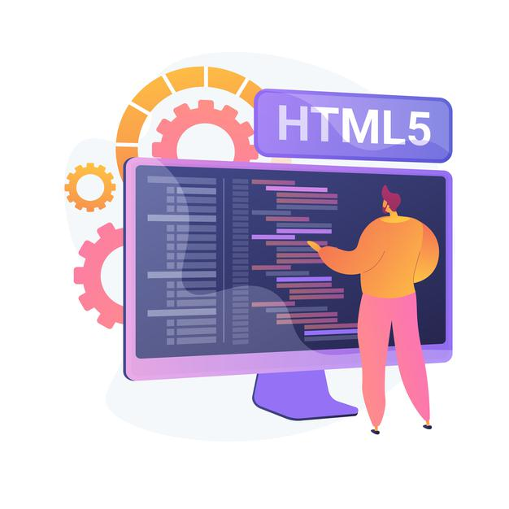
Some Important Points in HTML
HTML pages contains a header and a body, the body is what user sees.
HTML is a tree data structure
Each HTML element is called tag, we will have starting and ending tags.
Syntax
<tagName property=“value”>Content</tagName>
We can excess the Browser Dev Tools and Developer Toolbar by pressing F12 in the browser window.
HTML is not a programming language, it’s a markup language.
When we test HTML page in Browser, the generated tree data Structure is known as DOM – Document Object Model.
We can excess the HTML Documentation at https://www.w3schools.com/
Exercise code links
index.html
images

Slide 11

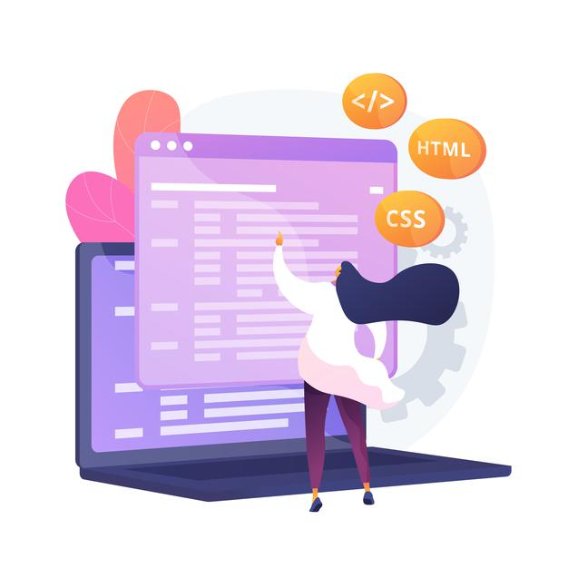
Introduction to CSS
CSS Stands for Cascading Style Sheets
CSS describes how HTML elements are to be displayed on screen, paper, or in other media.
CSS saves a lot of work. It can control the layout of multiple web pages all at once.
External stylesheet are stored in CSS file.
-We need CSS because HTML can only generate static content w/o coloring, formatting, borders, beautification.
Ways of applying CSS in an HTML :-
01 Inline CSS
02 Internal CSS
03 External CSS
In Inline Style CSS is applied along with HTML Element
In Internal type the CSS is applied at the Page level
In External type the a separate CSS file is created and linked to the Page

Slide 12

Box Model in CSS
In CSS, the term "box model" is used when talking about design and layout.
All HTML elements can be considered as boxes.
The CSS box model is essentially a box that wraps around every HTML element. It consists of: margins, borders, padding, and the actual content. The image below illustrates the box model:
1
Content: The Content of the box, where text and images appear
Explanation of the different parts
2
Padding: Clears an area around the content. Padding is transparent.
3
Border: A border that goes around the padding and content.
4
Margin: Clears an area outside the border. The margin is transparent.
Exercise code links:
index.html
style.css

Slide 13

Break

Slide 14
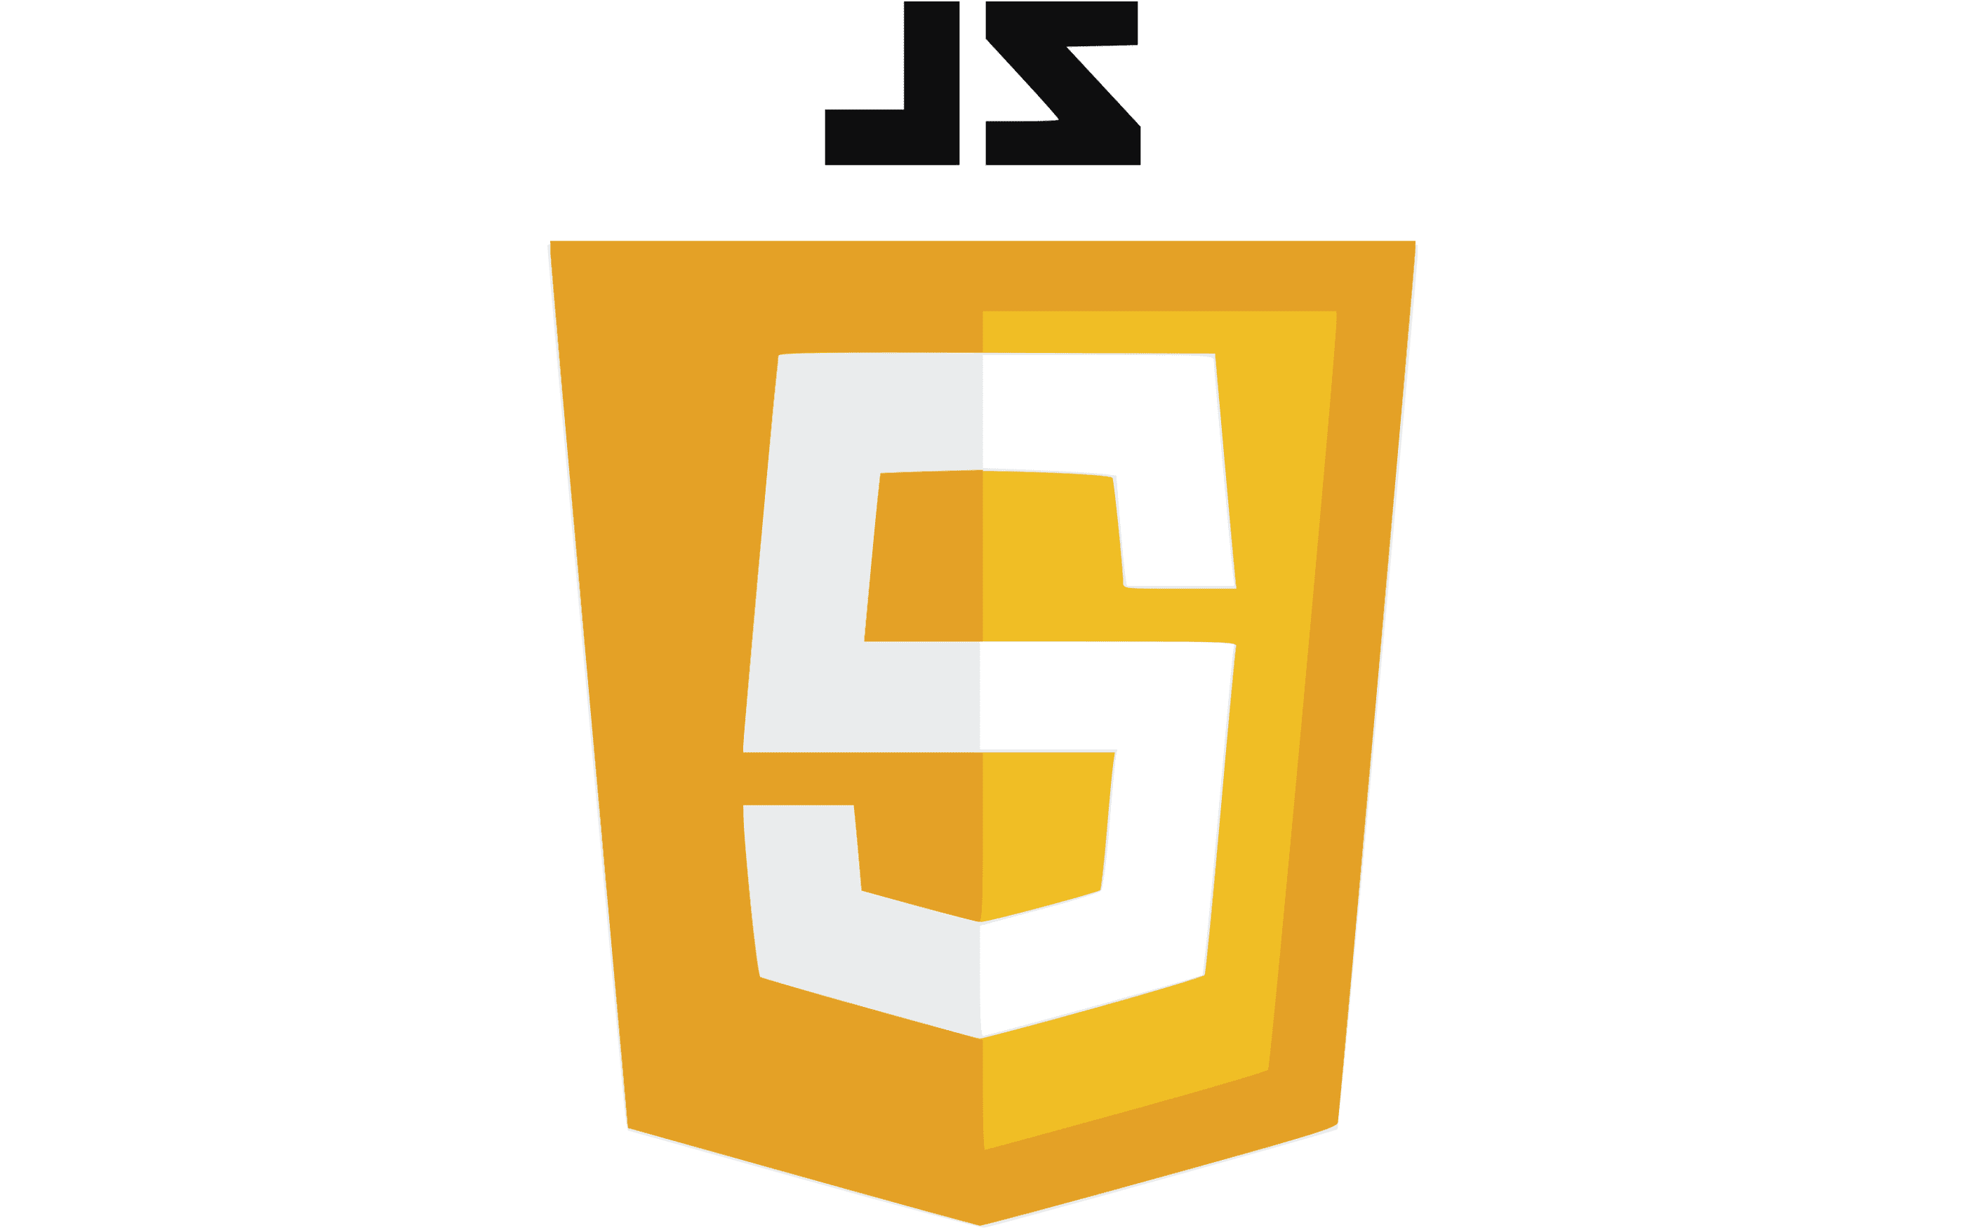
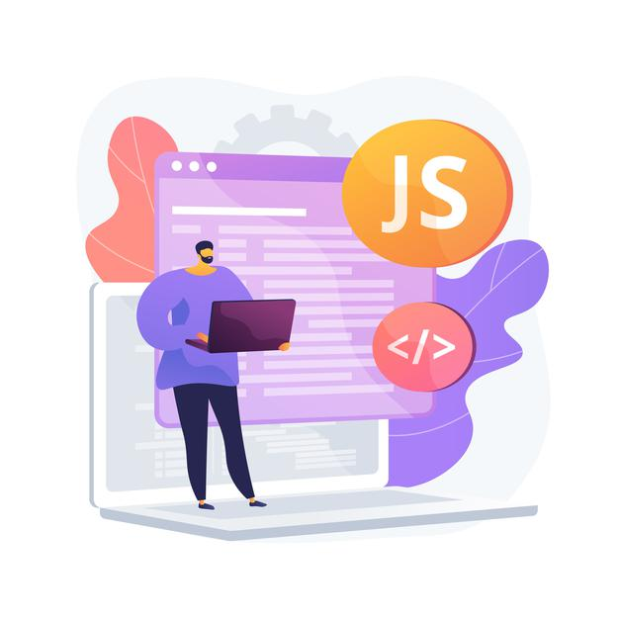
JavaScript
JavaScript is the programming language of the Web.
JavaScript is the world's most popular programming language.
It is an asynchronous non-blocking IO language.
JavaScript is a text-based programming language used both on the client-side and server-side that allows you to make web pages interactive.
Client-side JS – When code runs on Browser.
Server-side JS – When the code runs on webserver, e.g. NodeJS
Where HTML and CSS are languages that give structure and style to web pages, JavaScript gives web pages interactive elements that engage a user.
Types of function in JavaScript
There are 2 type of functions in JS
Anonymous Function – a function without name
Syntax: function(p1, p2 ) {
--code--
}
Named Function – a function with a name
Syntax:- function functionName(p1, p2) {
--code—
}

Slide 15

Some Important points of JavaScript
- How to apply JavaScript
There are 3 ways of applying javaScript on a page:
Inline JS :- It is applied at the element level. It cannot be reused.
Syntax:-
<tagname eventname=“code”></tagname>
Internal JS :- It is applied at the page level inside a special tag named <script> tag. We can write multiple functions in script tag.
External JS :- We move our code to an external file with extension .js or .ts and reuse the same using <script src=“”>
Debugging Shortcuts in Browser
F10 – step over – F6
F11 – Step inside – F5
Shift + F11 – Step out – F7
F8 – continue till next BP – F8
F5 – Whole page refresh

Slide 16
Synchronous and Asynchronous Response
User
Screen
Server
Database
Save
Processing
Time
Request send to server
Request to Database
Synchronous Nature
For all this time user
Remains blocked
Response form Database
Save
Request send to server
For all this time user
Remains blocked
Request to Database
Asynchronous Response
For all this time user
Is Not Blocked
Response from the server
Response form Database

Slide 17
Array and Object in JS
Syntax for Array
var aItems = [item0, item1,….]
Syntax for object
var oObjName = { “prop”: value,
“prop”: value,
“prop”: value }
Example of an Object
{
//this is an entityset of type object (single)
"empStructure": {
"empNo": 100,
"empName": "Latika Roongta",
"salary": 9000,
"currency": "EUR"
}
}
Java Script Object Notation – JSON
You can validate json using https://jsonlint.com
Elements or properties
Entity set
Exercise code link:
index.html
reuse.js

Slide 18


Introduction to jQuery
jQuery is a java script library which is
It’s free to use
Used by top software companies like google, Netflix, etc.
Light weight JS library
jQuery greatly simplifies JavaScript programming.
Available on internet
Purpose is to write less and do more
Industry standard
Syntax:-
$(selector).action();
Selector:-
tagName, .className, #id
Exercise code link:
index.html
reuse.js

Slide 19
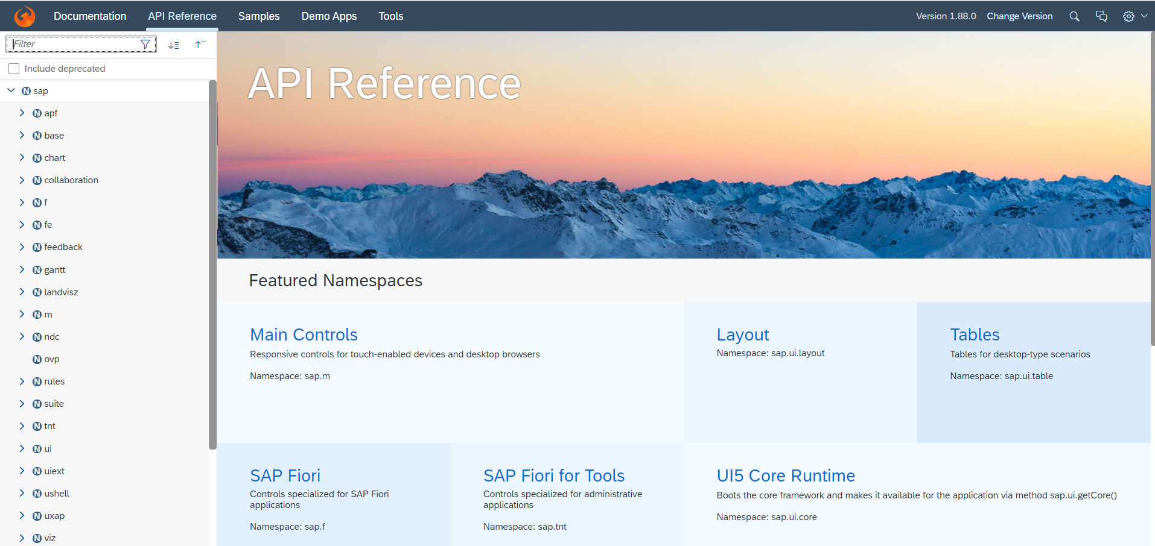
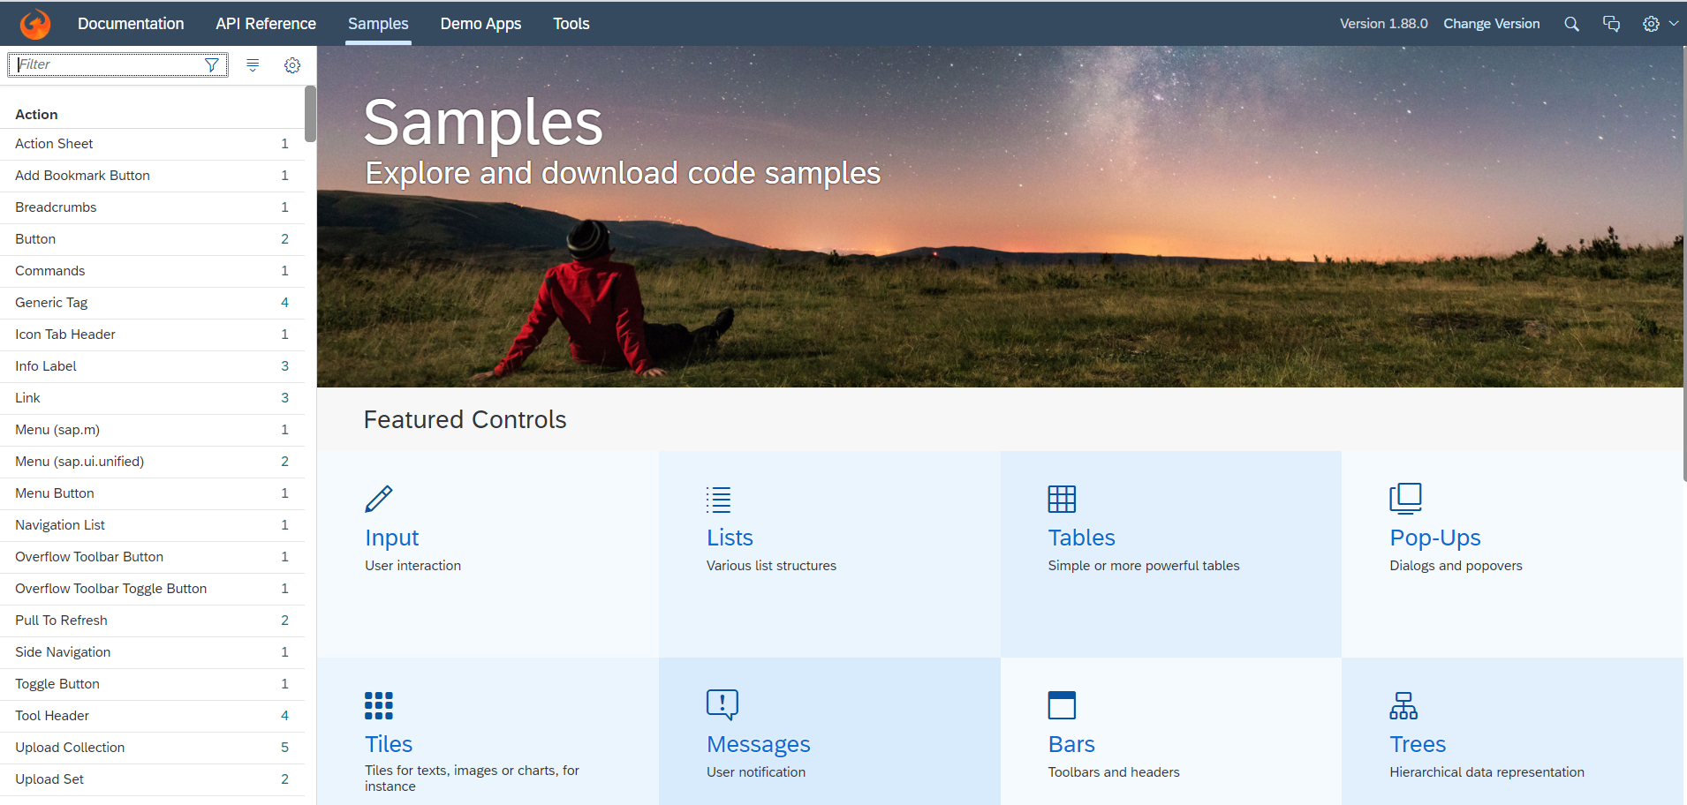
Introduction to UI5 SDK
Documentation of SAP UI5 is available at the SAPUI5 Software Development Kit.
We can access the SAP UI5 API’s at the Documentation page of SAP UI5 or you can use the link to go to sap’s API screen - LINK
We can directly search the required api’s on the SDK.
SDK contains the sample of all the controls which we can use in UI5
SAP UI5 API reference screen
SAP UI5 Sample reference screen

Slide 20
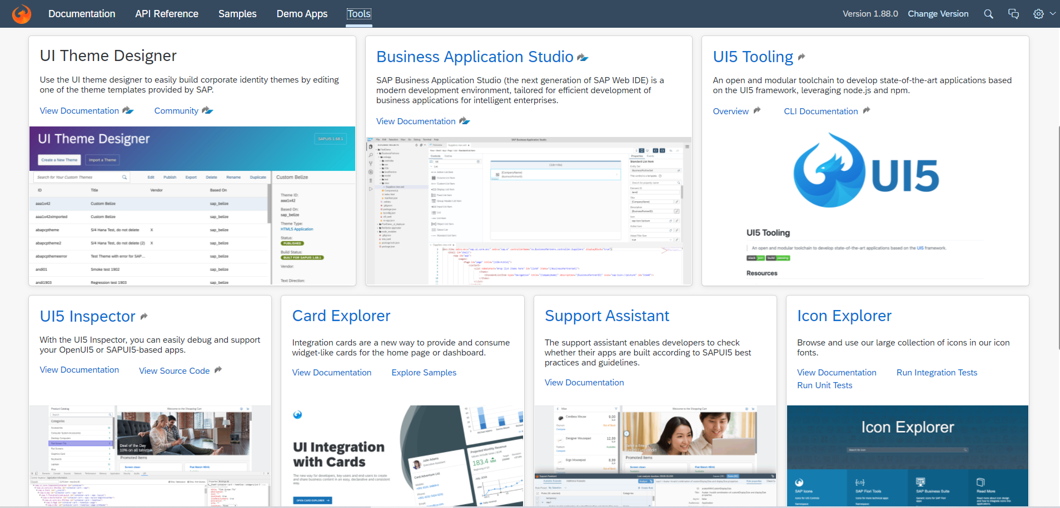
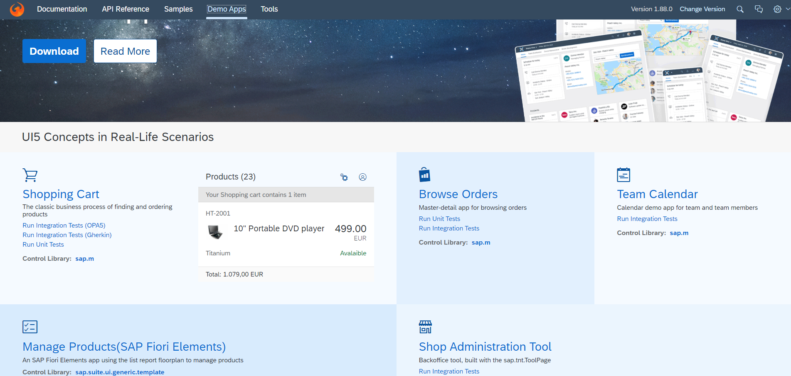
UI5 SDK continues…
UI5 SDK contains tools to make the development smooth for the developers.
It has UI5 icon packs which can be directly accessed for the UI5 SDK’s Tool Screen (Link).
SAP UI5 SDK provides us the demo application, So we can get an idea about how to create different type of applications using UI5 controls
UI5 SDK Tools Screen
UI5 SDK Demo Apps Screen

Slide 21
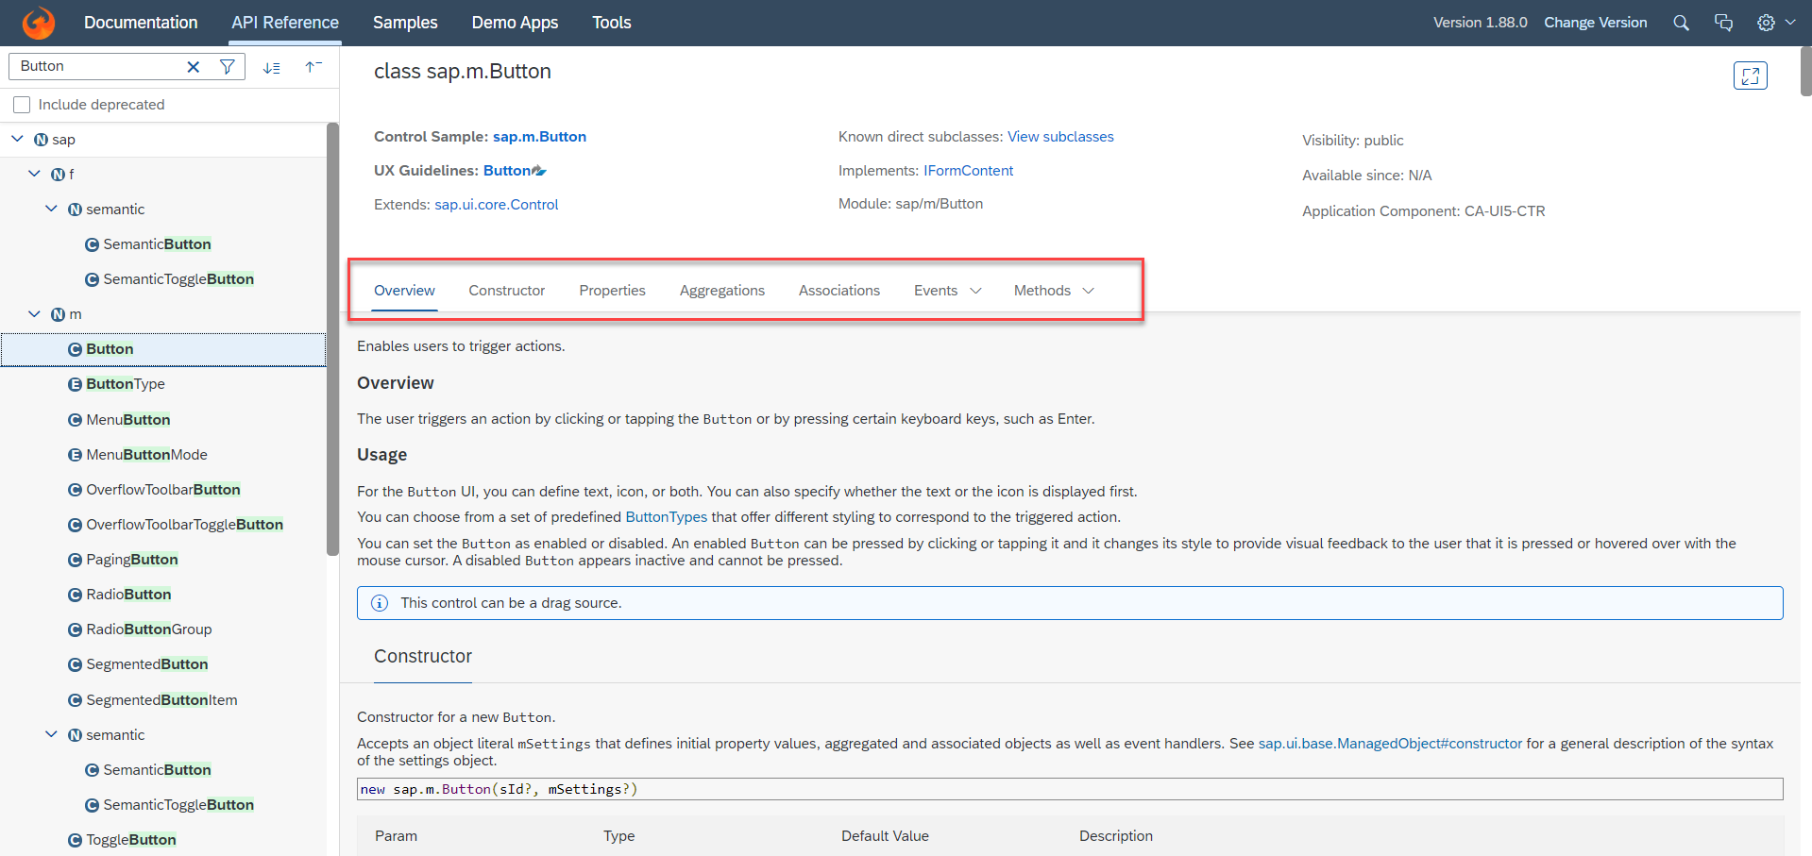
UI5 SDK continues…
When we search and open any API we see a screen similar to one which is shown below.
Every API contains different kind of:
Properties,
Aggregations,
Associations,
Events,
Methods

Slide 23

End of Day 1

Slide 24

Questions

Slide 25

Anubhav Oberoy

Slide 26


We’re committed to empower you to be
Most Desirable Resource
through powerful training solutions.
We build the workforce of the future.
250+
Corporate Clients
30,000+
Learners Trained
25000+
Learners Placed
FREE WEBINARS
Sign up for free webinars with industry experts every fortnight!
Enroll Now!
Contact us today!
https://anubhavtrainings.com/

Slide 27




More from AnubhavTrainings.com

